Slide 1
Predicting the NBA Champions
Abdur Rafeh Shah
Javier Cao Cao
Tianfang (Colt) Geng

Slide 2

Overview
One of the major global sports
Approx 2.2 billion fans worldwide
Approx revenue: 8.8 billion USD (2018/2019)
Projection of 10 billion USD
8 month season followed by the playoffs
Playoff prediction based on season performance
Economics of city -> boosts tourism
Betting -> predicting NBA champions

Slide 3

Objective
At RJC Analytical Solutions -> utilize past NBA season data to predict the team that has the highest likelihood of winning the playoff championships (seasonal data)
Provide solutions to major betting companies to become profitable
Provide a technical advantage
Become a market leader in the sports betting industry

Slide 4
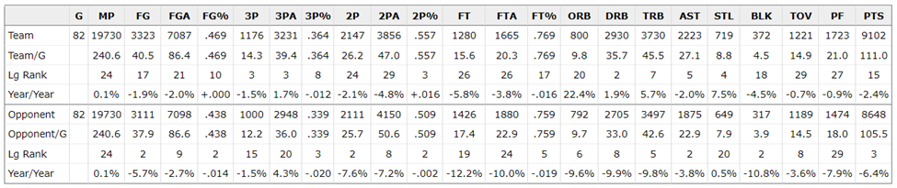
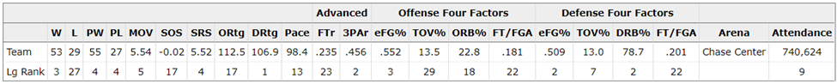
Data Collection & Pre-processing
Main source: Basketball Reference
Data contains Team, Opponent, Miscellaneous statistics
Dependent variable: # of playoff wins

Slide 5
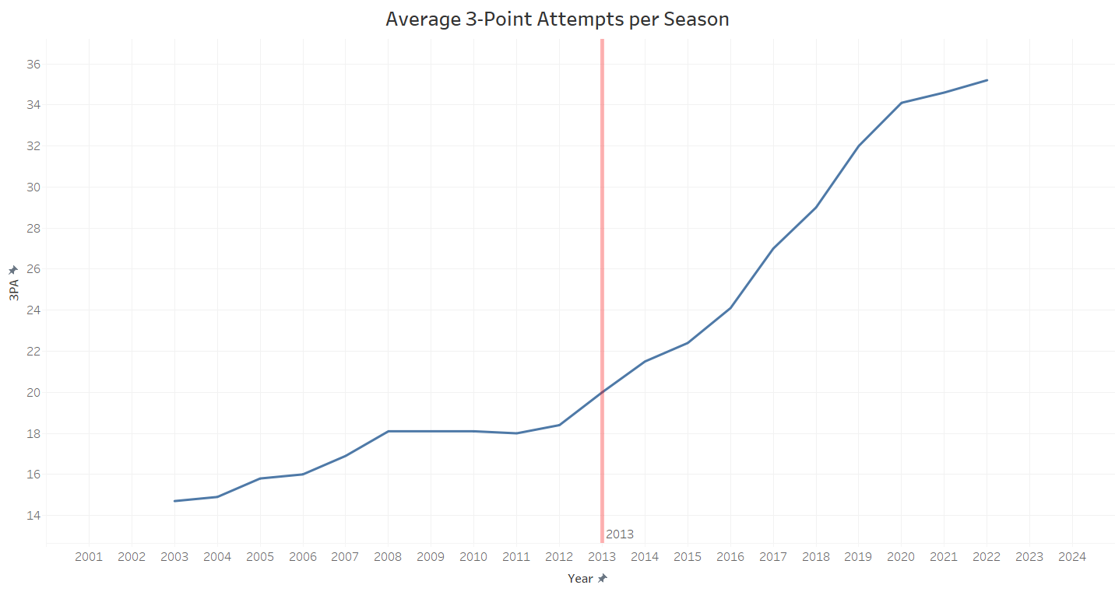
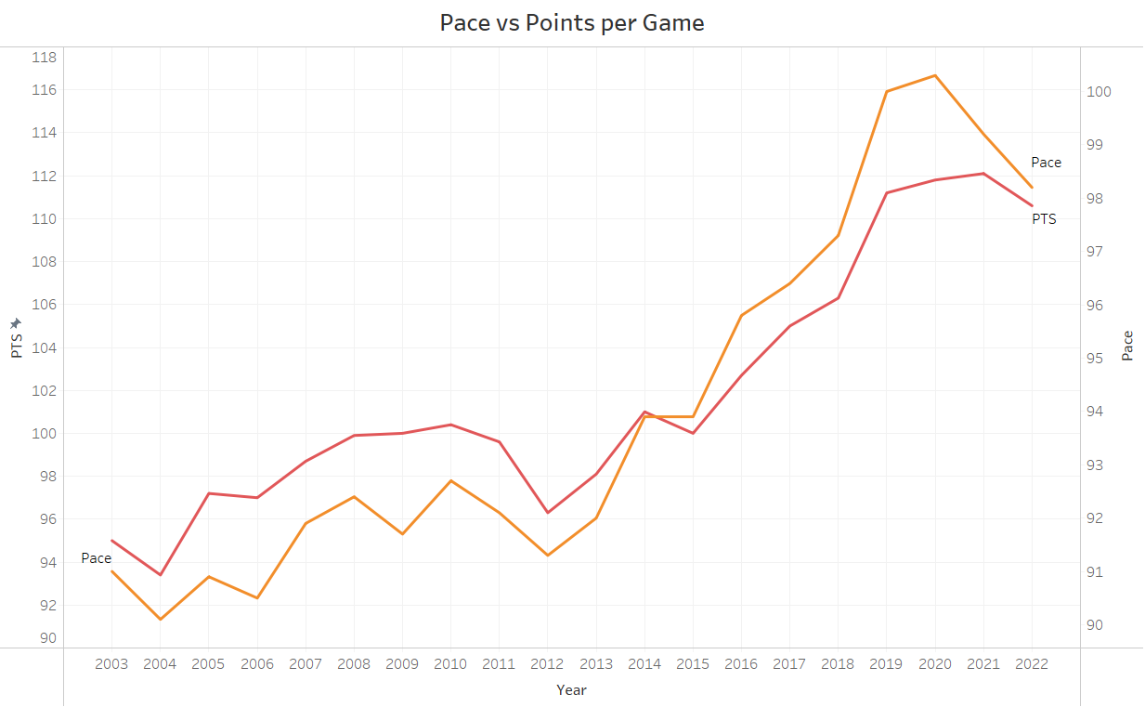

Data Collection & Pre-processing
Preprocessing steps:
Data after 2002-2003 season
Only teams who qualified to playoffs
Ranks instead of game numbers
Removed highly correlated variables

Slide 6
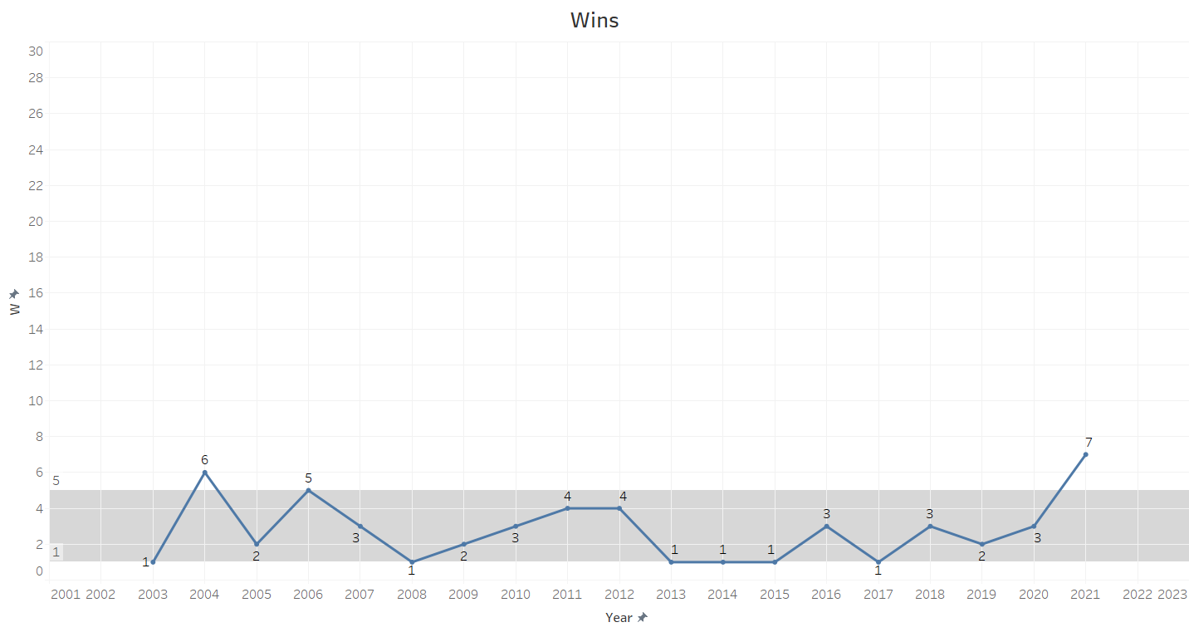
Data Exploration - Miscellaneous

Slide 7
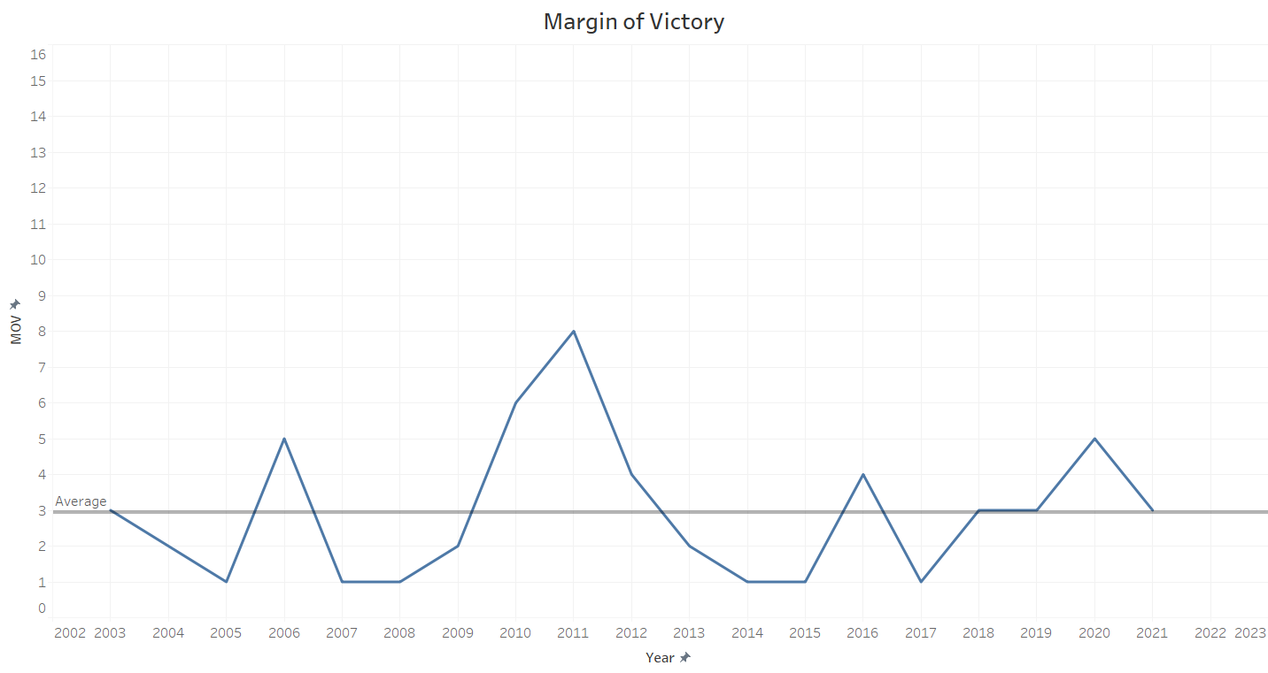
Data Exploration - Miscellaneous

Slide 8
Linear Regression Predictive Model
Feature Selection & Cross Validation
Forward:
Backward & Stepwise:
Number of Wins Rank (W) [ - ]
Opponents Blocks (O_BLK) [ - ]
Strength of Schedule (SOS) [ + ]
Offensive Turnover Percentage (TOV_perc) [ + ]
Number of Wins Rank (W) [ - ]
Offensive Turnover (TOV) [ - ]
Points Rank (PTS) [ - ]
Strength of Schedule (SOS) [ + ]
Offensive Turnover Percentage (TOV_perc) [ + ]

Slide 9
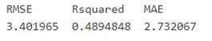
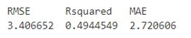




Linear Regression Predict Model
Error Term & Predict Results
Forward:
Backward & Stepwise:

Slide 10
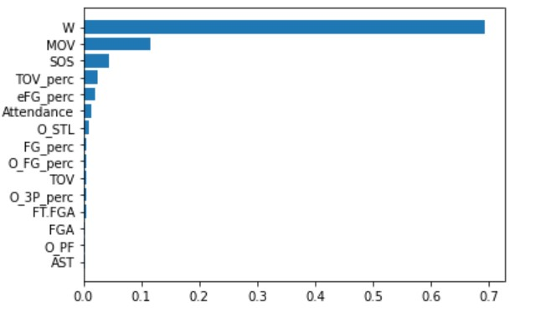
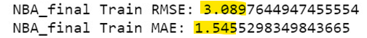
Random Forest

Slide 11
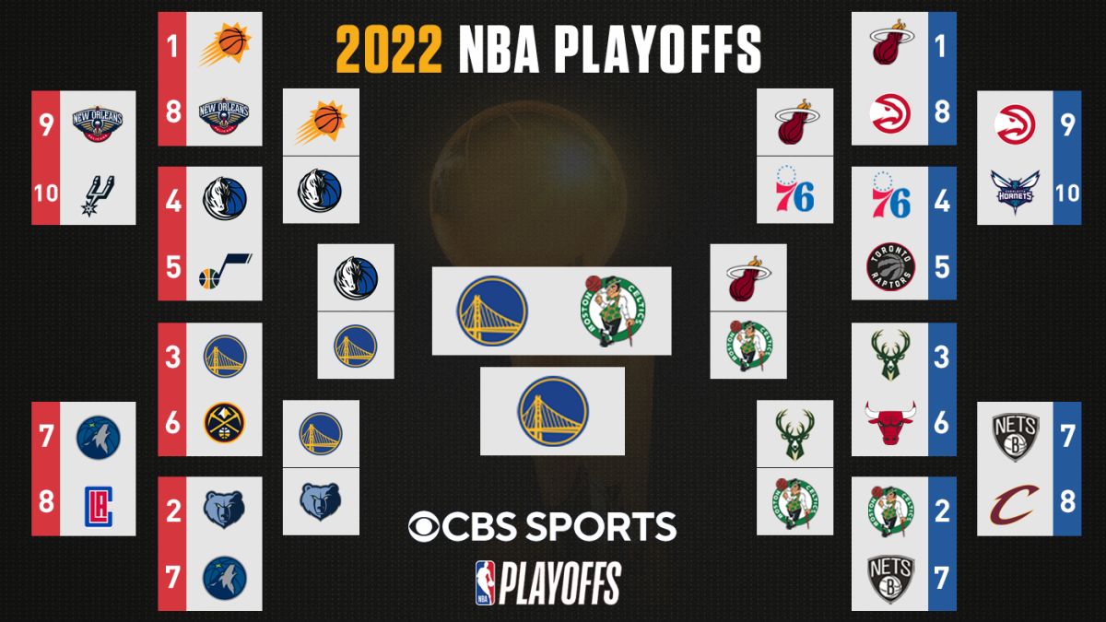

Slide 12
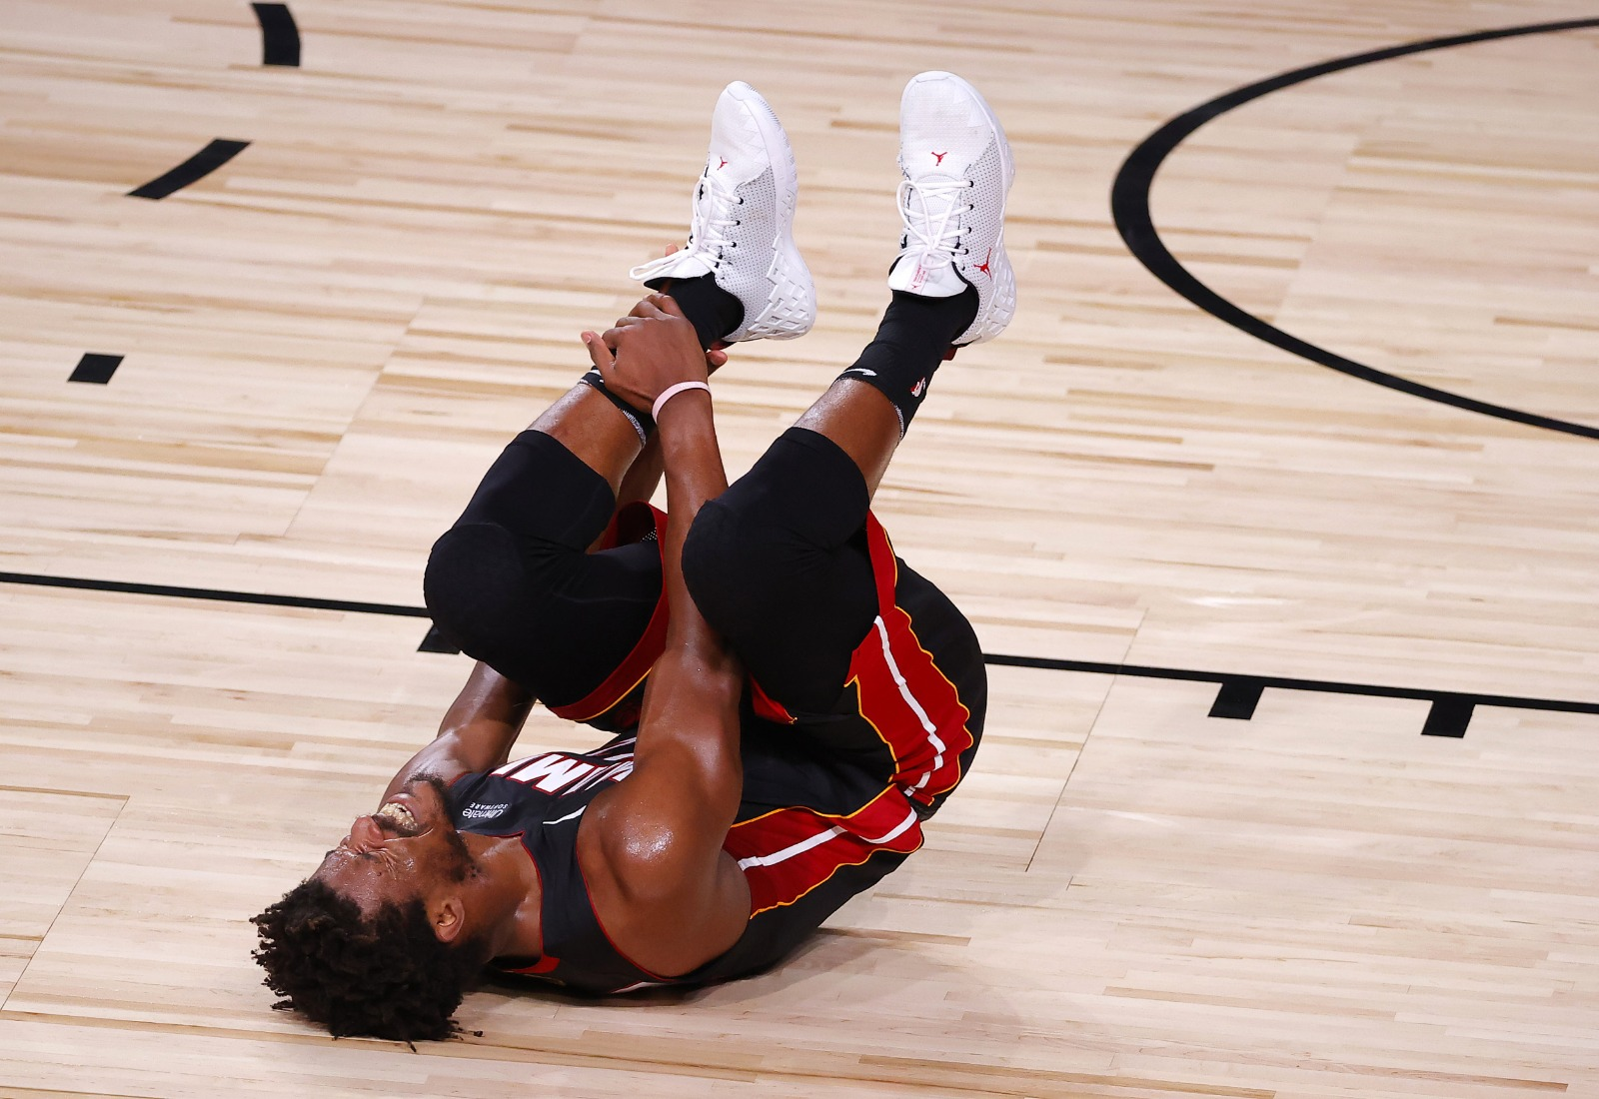
Model Risks and Limitations
Uncertainty during playoffs
Injuries
Psychological factors (e.g., pressure & experience)
Intangible factors
Coaching
Strategies
Regression & Random Forest results are not perfect
Small sample size
“Negative wins”

Slide 13
Conclusion and Recomendations
Utilized 4 prediction models
Linear (Base, forward and backward) and Random Forest
All 4 models predicted the same teams: Phoenix Suns, Miami Heat, Golden State Warriors
Random Forest chosen as model of choice (lowest error)

Slide 14
Conclusion and Recommendations Cont’d
NBA champions significant factors:
Good overall performance in the regular season
Having a high margin of victory (MOV) as it indicates team strength and dominance relative to other teams
Be efficient when shooting
Have high points per game
Have low turnovers
Have a relatively easier game schedule

Slide 15

Thank You!

